Slide 1
DOELAP Assessor Training
Online Test
September 2026

Slide 2
Summary
The DOELAP assessor training test will need to be taken online:
The assessors can use the training presentations for the test.
The training presentations will also be available on the RESL website under the DOELAP tab at
https://resl.id.energy.gov/doelap/doelap.html

Slide 3
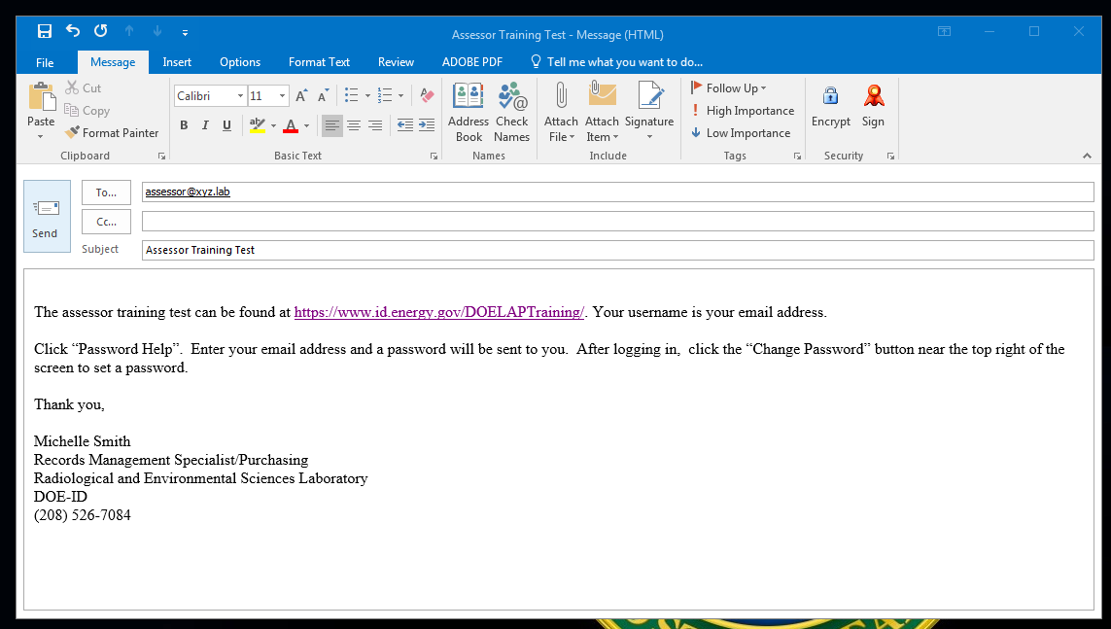
Email Information
The training link and login instructions will be emailed to each assessor.

Slide 4
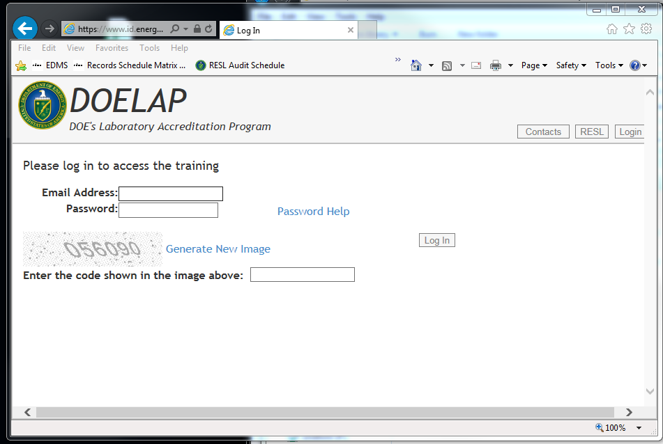
Login Screen
The username is the assessor’s email address. Click on “Password Help” to receive a temporary password.

Slide 5
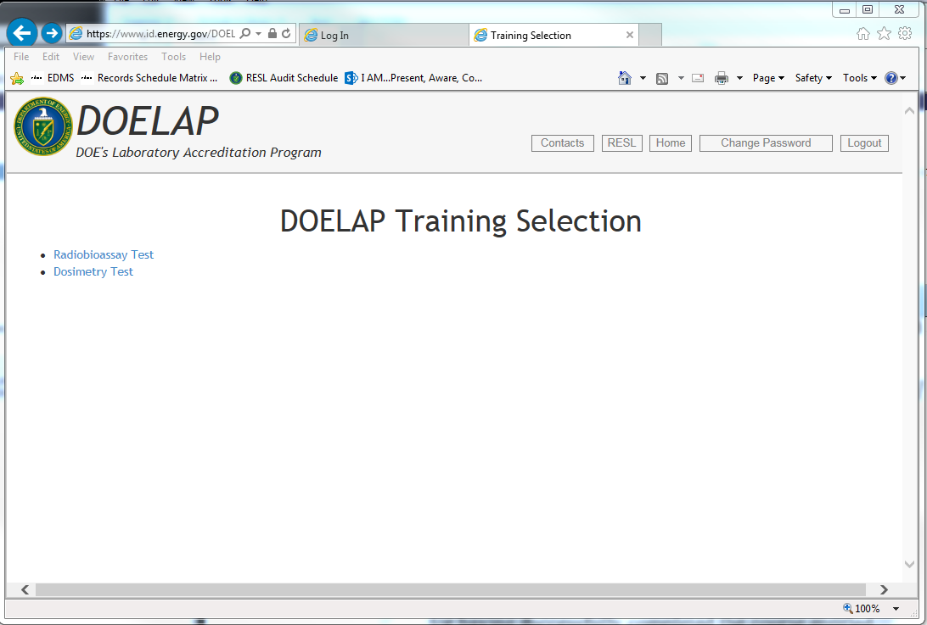
Choose Test

Slide 6
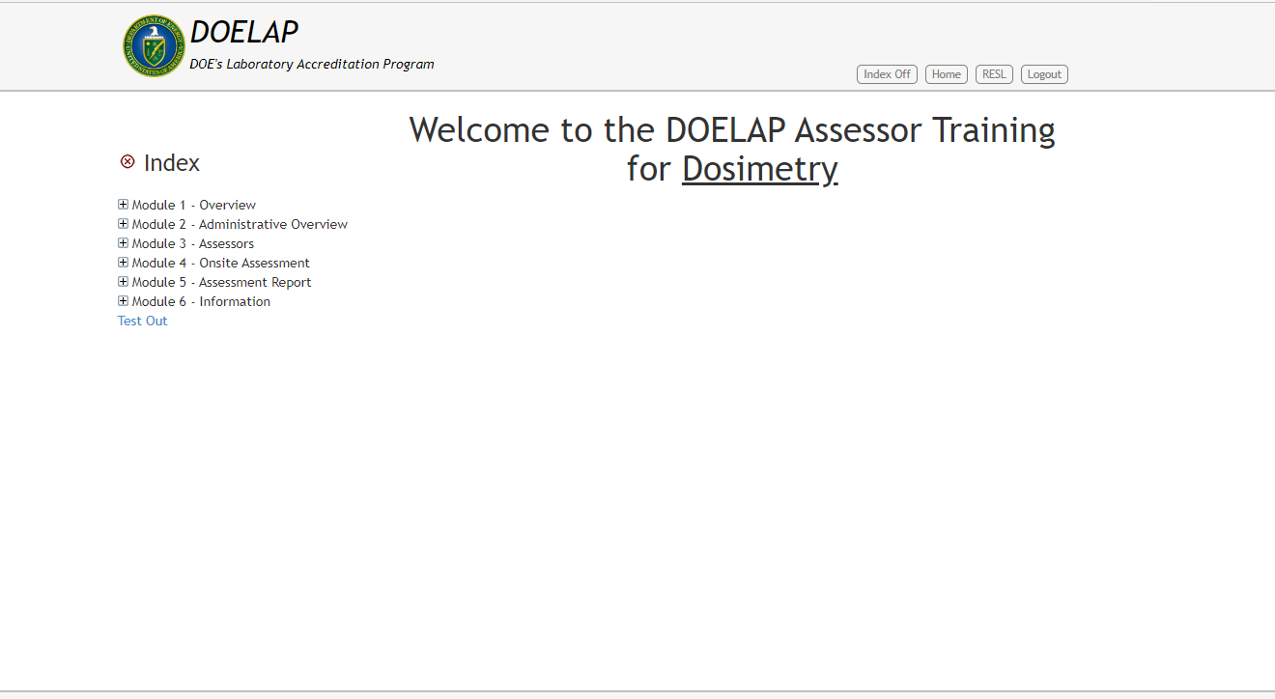
Test Out

Slide 7
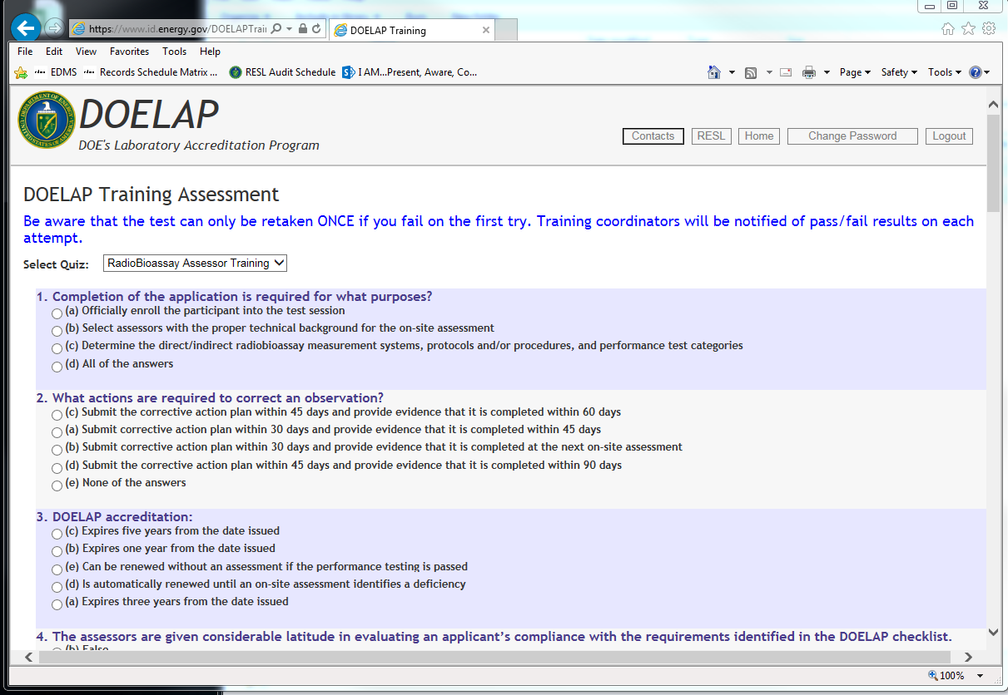
Test Example

Slide 8
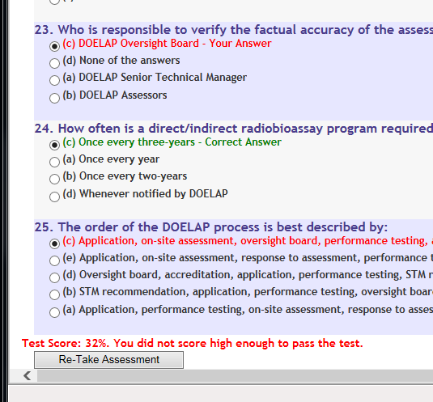
Test Information
After the test is finished, the score will appear on the screen indicated a pass or fail.
Assessors must get at least an 80% on the test to pass.
If an assessor fails the exam, they will only be allowed to retake it once.

Slide 9
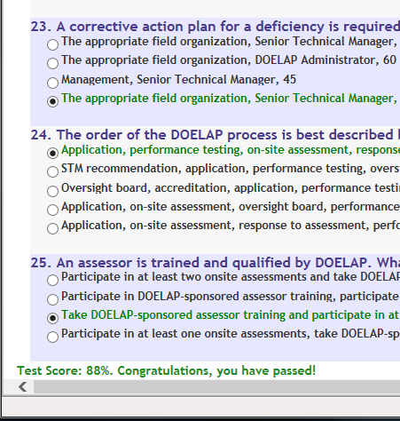
Test Information (continued)
If an assessor fails the exam twice, they will be contacted by the Senior Technical Manager.
After the assessor passes the test, the training completion certificate will be emailed to them.

Slide 10
Questions?

